Slide 1
Comparing Game Tree Search Techniques
By Alastair Rayner

Slide 2
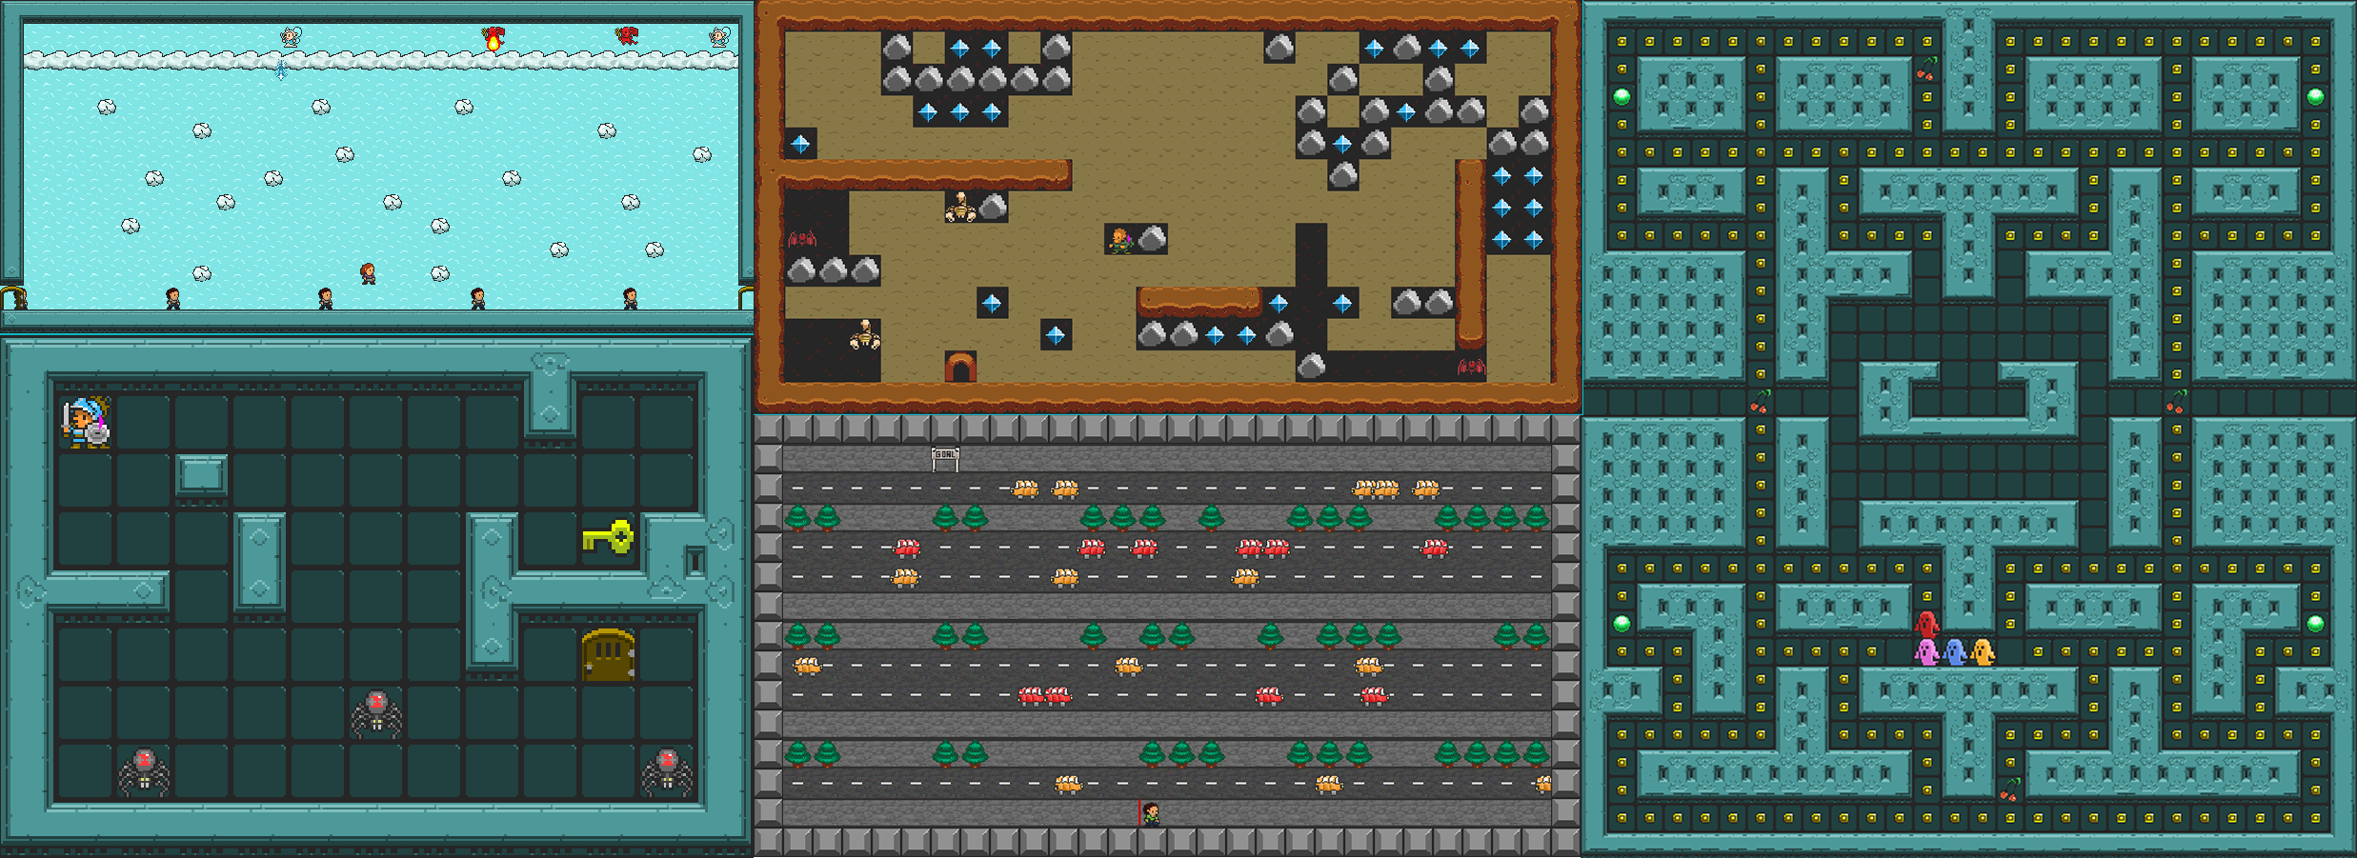
What I aimed to achieve
Using the GVG-AI competition as a framework to compare the different tree searching algorithms

Slide 3
Issues I encountered
Collecting the data
Incomplete data set
Time it took to run the simulations
Leaving it till late
Only had 10 results per level
Not having a defined goal until near the end
Only near the end I decided on comparing how level size effects tree search's

Slide 4
Collecting the Data
To collect the data I used a bunch of cloud servers
Wrote a python script to run the simulations concurrently
Wrote a json to csv converter for the data

Slide 5
Results I gathered
Two sections
Visualisations
Data Collection

Slide 6
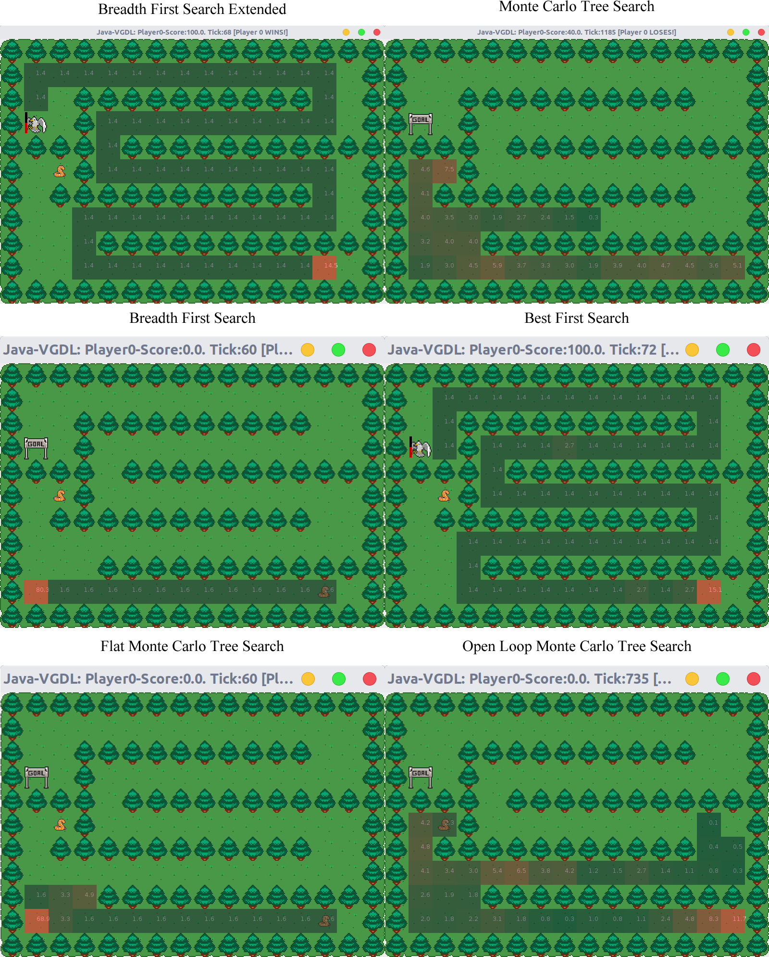
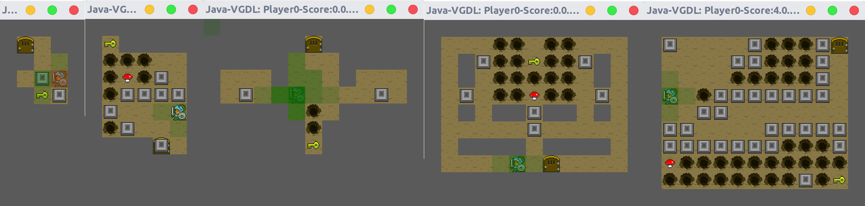
Visualisations
Above:
Comparing search area (MCTS)
Left:
Comparing the time spent in each cell

Slide 7
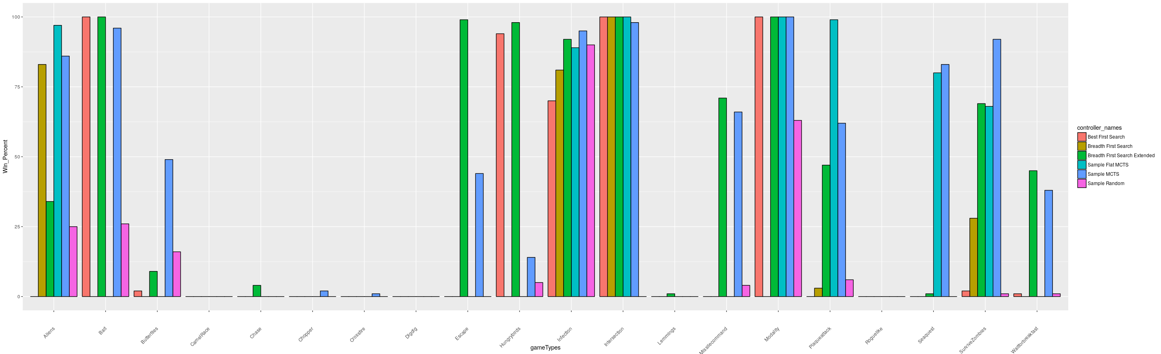
Data Collection

Slide 8
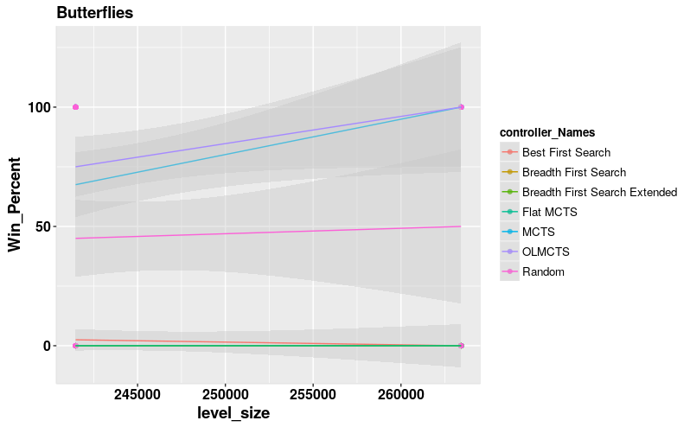
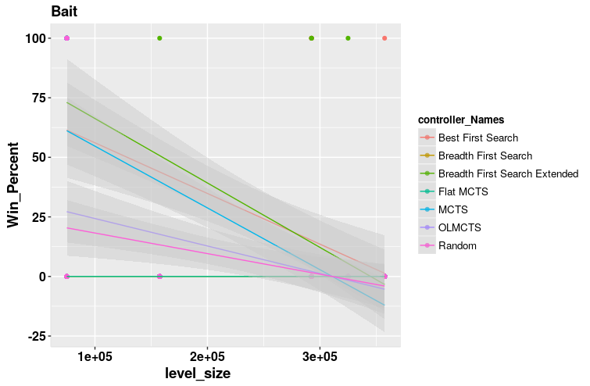
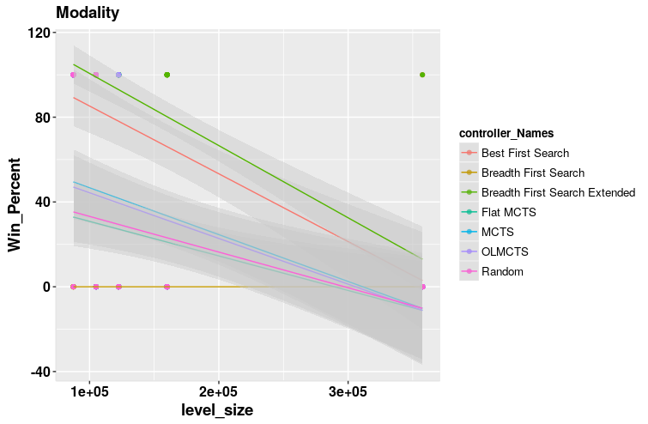
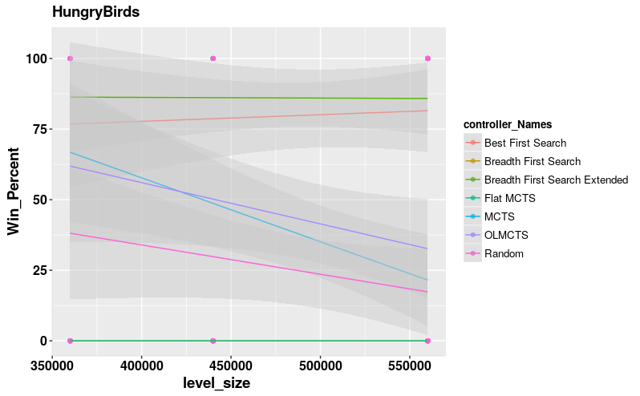
Win comparisons

Slide 9
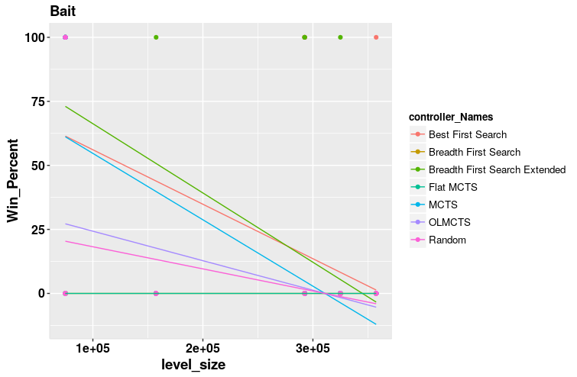
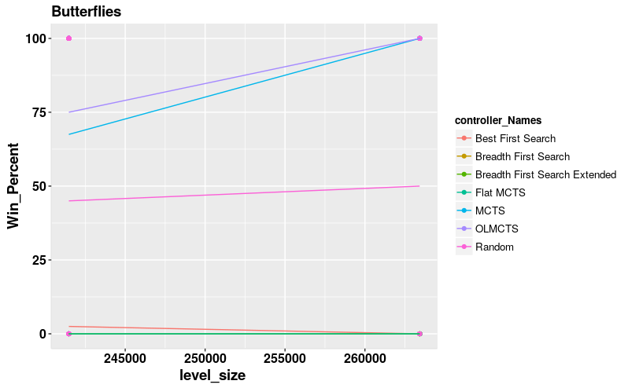
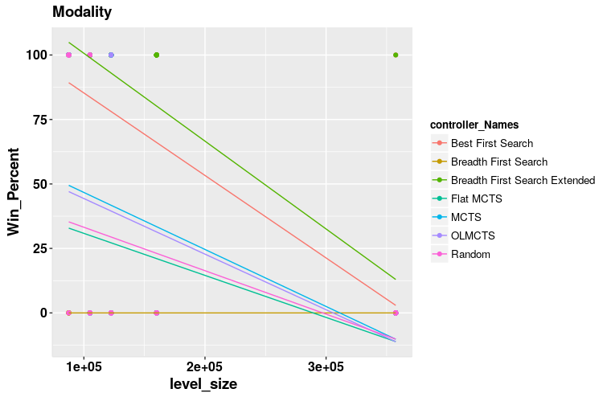
Win W/O variance comparisons

Slide 10
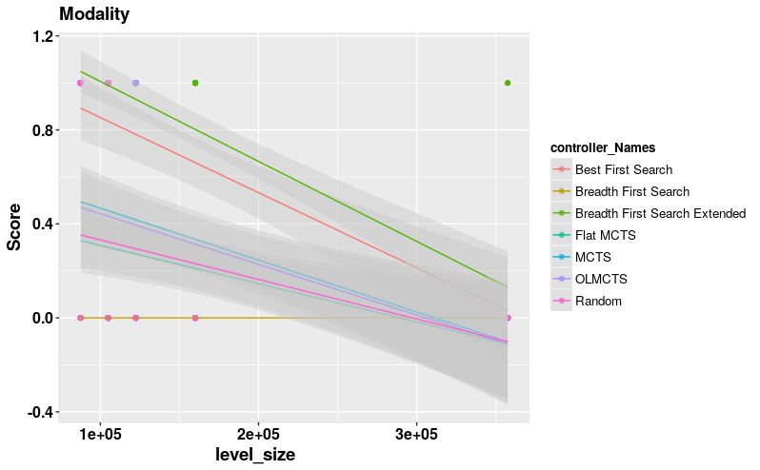
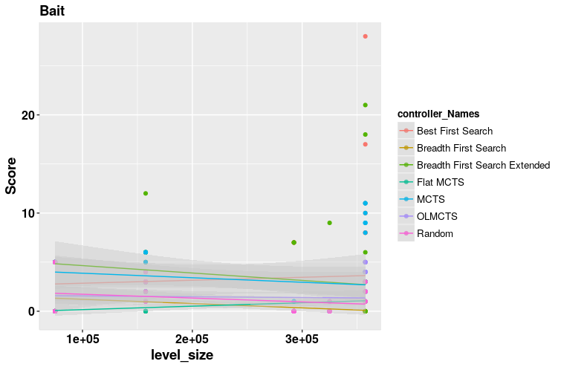
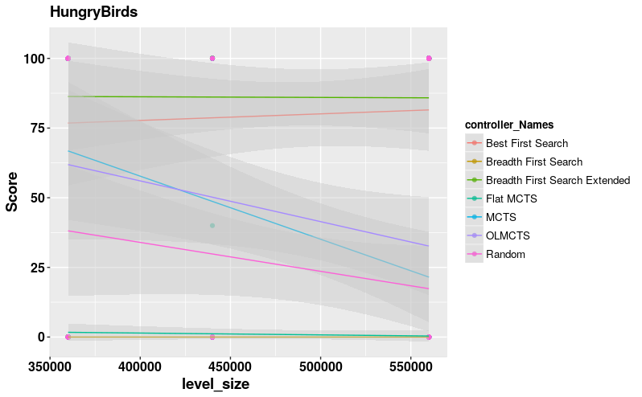
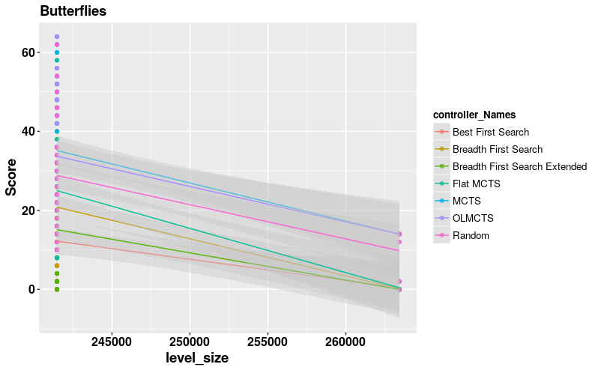
Score comparisons

Slide 11
Contribution to knowledge
Better insights into how these techniques can be used to improve AI.

Slide 12
Claims made

Slide 13
Questions?

